Slide 1
ICAP
Intelligent Cognitive Alarm Platform
An AI-powered mobile application that builds healthy wake-up habits through cognitive challenges
Frontend Development Overview | Jothiesh N Team-3

Slide 2





Project Overview
KEY FEATURES
The Intelligent Cognitive Alarm Platform (ICAP) is an AI-powered mobile application designed to help users develop healthy wake-up habits. Unlike traditional alarm apps, users must complete AI-generated cognitive challenges to dismiss alarms.
AI-Based Cognitive Challenges
Smart Alarm Scheduling
The platform also provides role-based dashboards for Users, Wellness Coaches, and Administrators to monitor performance, Habit Scores, and user progress.
Automatic Habit Score Calculation
Role-Based Access Control
Performance Analytics Dashboard

Slide 3



My Contribution
My Role Frontend Developer
Application Build
Dashboards & Architecture
Developed the complete React Native mobile application
Designed responsive and user-friendly interfaces
Implemented role-based navigation for User, Coach, and Administrator
Integrated frontend with FastAPI REST APIs
Developed User Profile and Alarm Scheduling modules
Developed Habit Score, Coach, and Administrator Dashboards
Implemented analytics, monitoring, and dashboard visualizations
Managed frontend architecture using reusable components

Slide 4



Technology Stack
Frontend
React Native
TypeScript
Redux Toolkit
React Navigation
Axios
Expo
Type-safe development
State management
Routing & navigation
API communication

Slide 5






Frontend Development
React Native Mobile Application — Developed Modules
Splash Screen
Login & Registration
Forgot Password
User Profile
Alarm Scheduling
Role-Based Navigation
Habit Score Dashboard
Coach Dashboard
Administrator Dashboard

Slide 6
Updated Frontend Application Enhancements
Habit Score Dashboard
Administrator Dashboard
Replaced manual Habit Management with an AI-based Habit Score system
Automatic score calculation based on challenge difficulty & completion time
Weekly & monthly analytics with challenge history insights
Coach assignment to users
Complete user & coach management
Habit Score and challenge performance monitoring
Search, filter & sorting functionality
Coach Dashboard
UI Enhancements
View assigned users & performance monitoring
Habit Score analytics and challenge statistics
Progress charts and individual user reports
Modern, interactive analytics charts
Responsive card-based layout
Improved navigation & real-time dashboard updates

Slide 7
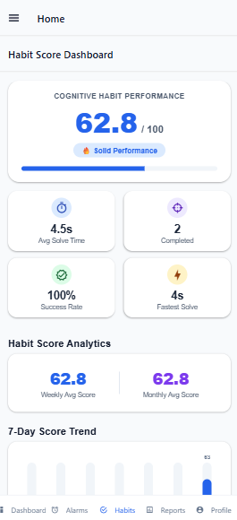
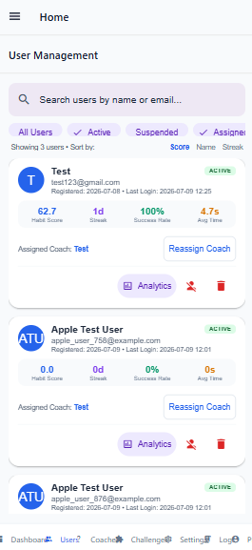
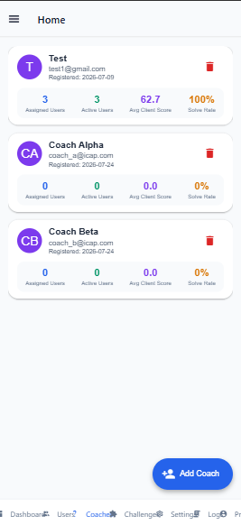
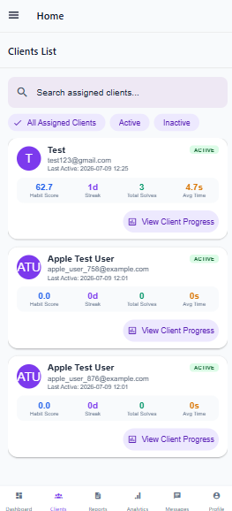
Updated Frontend Application Snapshots
User
Admin
Coach

Slide 8



Future Work
AI Cognitive Challenge Engine
Application Testing
Deployment
Integrate the AI-powered Cognitive Challenge Engine
Generate personalized cognitive challenges
Dynamically adjust difficulty based on user performance
Perform end-to-end functional testing
Validate frontend and backend integration
Conduct usability and performance testing
Fix bugs and optimize performance
Deploy the FastAPI backend to a cloud platform
Publish the React Native mobile application
Configure production database and APIs
Enable secure and scalable application access

Slide 9

Conclusion
Successfully developed the frontend of the Intelligent Cognitive Alarm Platform using React Native
Implemented secure role-based interfaces for Users, Coaches, and Administrators
Built an AI-based Habit Score Dashboard with performance analytics
Developed comprehensive monitoring dashboards for administrators and coaches
Enhanced the application with real-time analytics, coach assignment, and user performance tracking
Delivered a responsive, scalable, and user-friendly mobile application integrated with backend services

